Slide 1


Virtual Computer Mouse using mmWave Radar (TI):
Oscar Chavez Araiza
Greyson Heath
Daniel Lu
Zane Meikle
ECEN 403

Slide 2
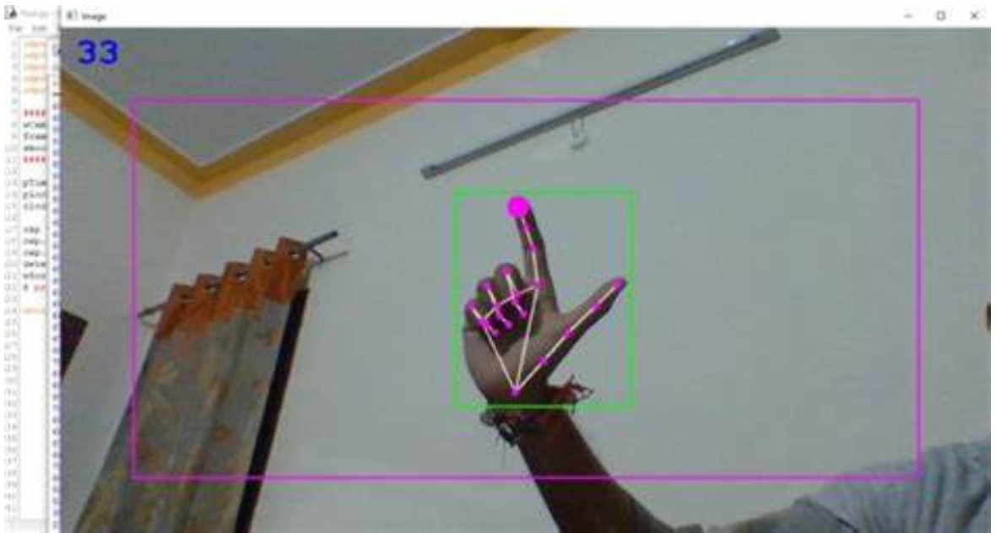
Project Description:
Problem statement:
Virtual mice today are traditionally done using computer vision and a camera (as seen on the right).
But these systems are processing and power intensive.
Solution proposal:
Create a virtual mouse using a Texas Instruments (TI) mmWave Radar and a ML model to make a less power and processing intensive virtual mouse.

Slide 3
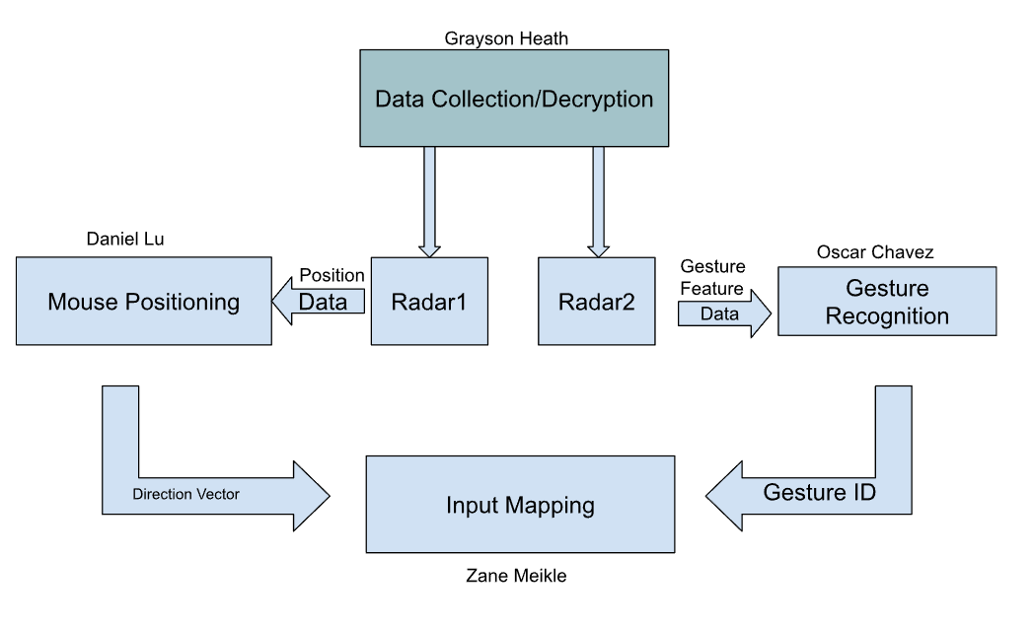
System Overview

Slide 4
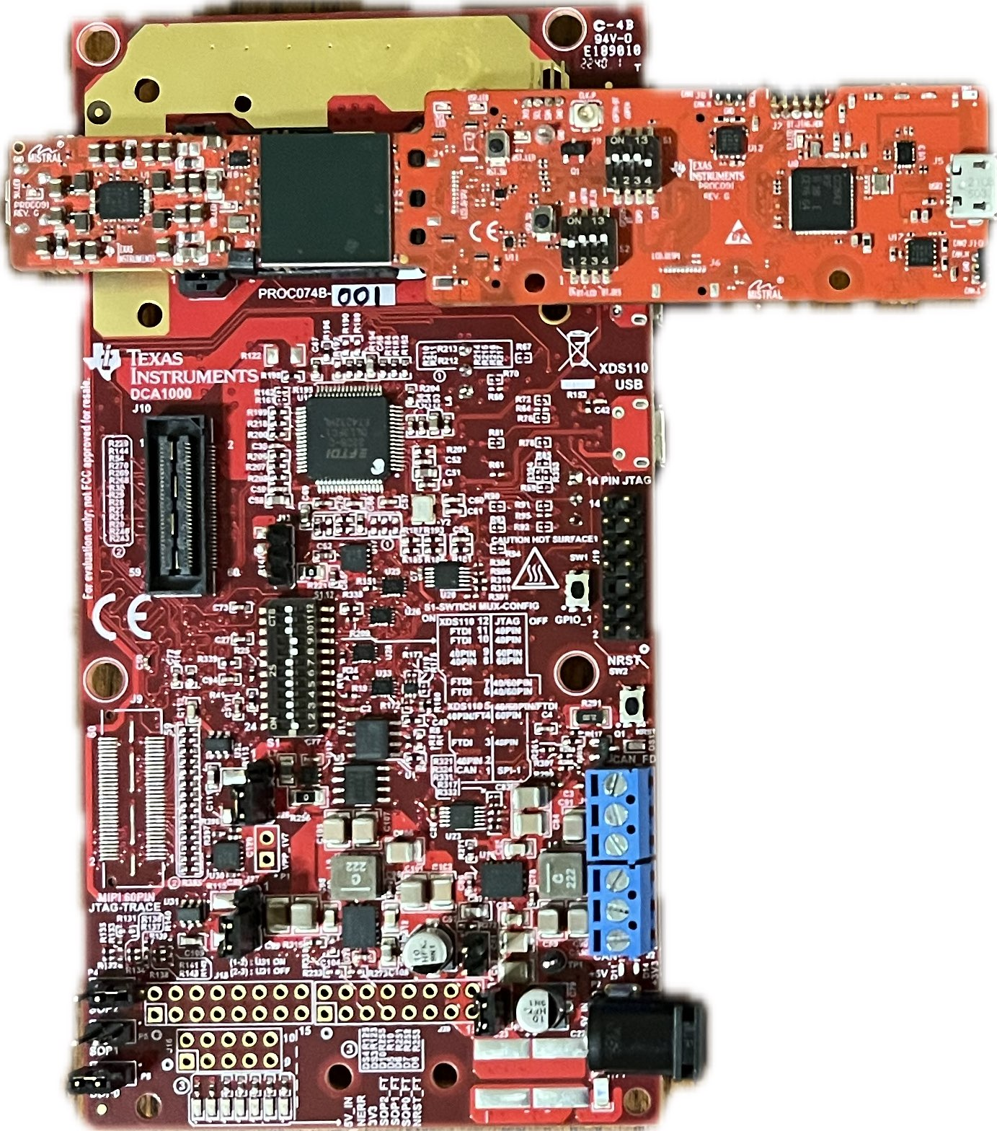


Chirp Config / Collect Data
Greyson Heath
Accomplishments since the last presentation <17.5> hrs | Ongoing progress/problems and plans until the next presentation
<10> Point-cloud and ML Gesture Demo <4> UART Data Output and Understanding <3.5> Sponsor Meetings | Problems: Radar demo connectivity issues, scope of project changing Ongoing progress: Making the two radars work in parallel with separate programs, collecting and organizing live data

Slide 5
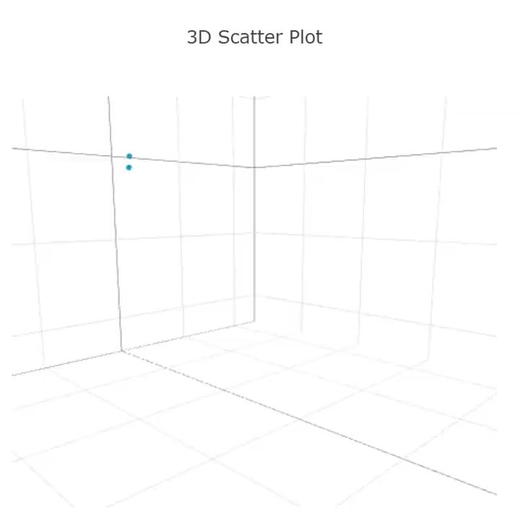
Point-Cloud Modified Chirp Demo

Slide 6
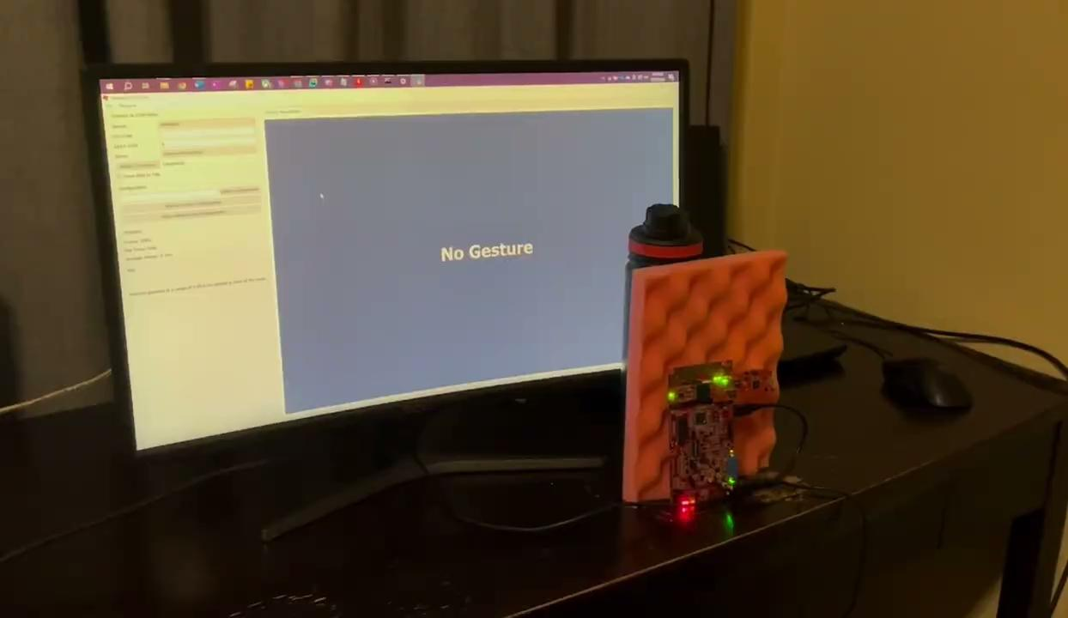
Gesture with ML Demo

Slide 7
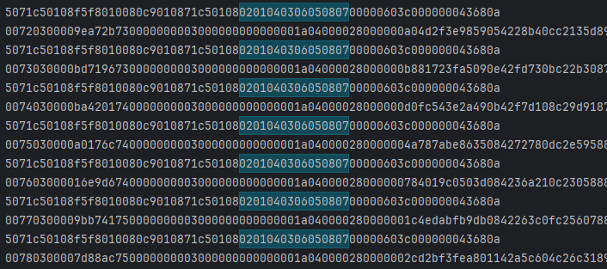
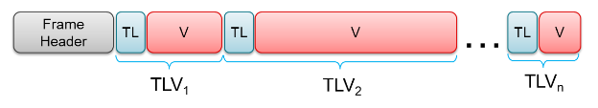
UART Data Output
…
…
…
…
…
…
…
Notes:
-Radar outputs data using a type-length-value encoding scheme. Per frame (single set of data), a packet is sent which always consists of a 40-byte frame header, and a variable number of TLV’s depending on what was detected. Within the TLV’s exists data such as X, Y, Z, doppler, range, number of points, and elevation.

Slide 8
-Gesture Recognition-
Oscar Chavez Araiza
Accomplishments since the last presentation <17> hrs | Ongoing progress/problems and plans until the next presentation
<3.5> Meeting with advisor - Ended in redefining the project to account for low resolution. (new range of about a foot) <6> Reviewing viability of project <5> Looking for a suitable model to train for project <2> Feature extraction research <0.5> Re-defining usable gestures/no to almost no movement | Problems Second-guessing the functional range of our project. Data points were too scarce to confidently predict gestures. Scope of the project changed No-measurable progress due to lack of data. On-going progress Obtaining data to retrain model for a lower amount of gestures.

Slide 9
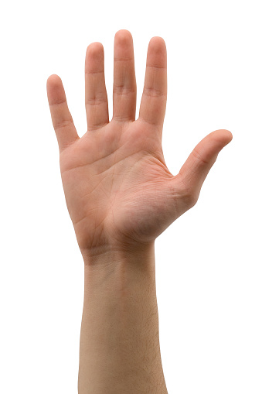
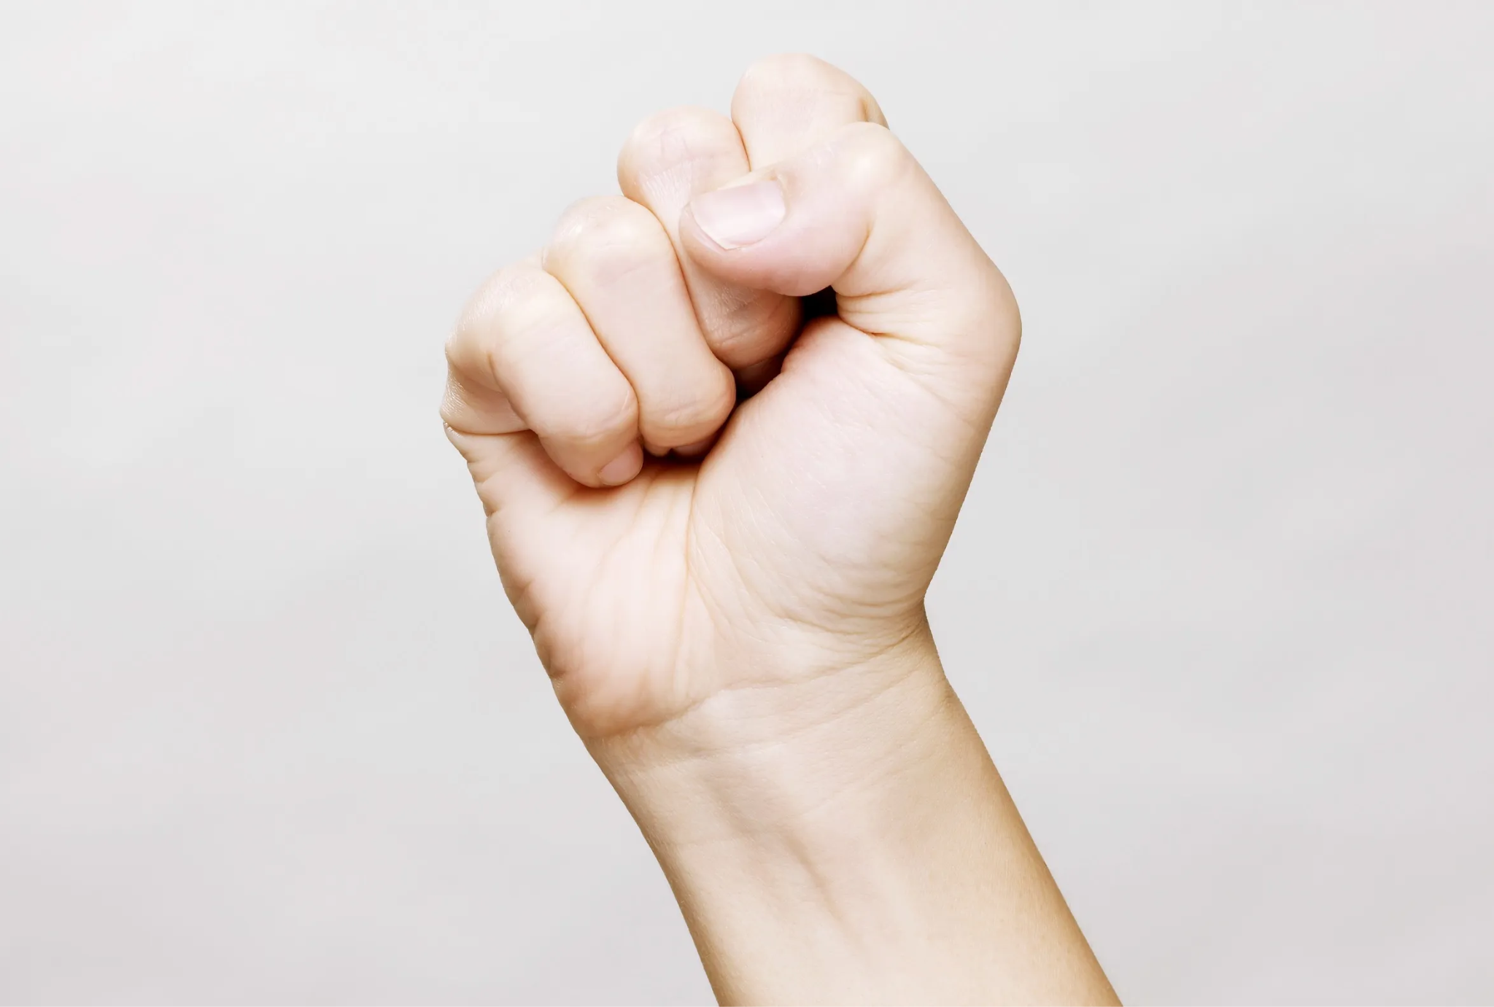
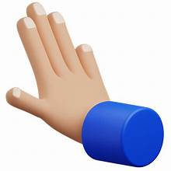

Gesture Recognition
Gesture 1 (L-Clk)
Shine Gesture
Gesture 2 (R-Clk)
Push Gesture

Slide 10
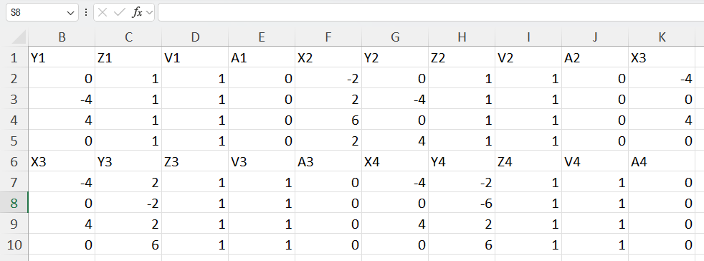
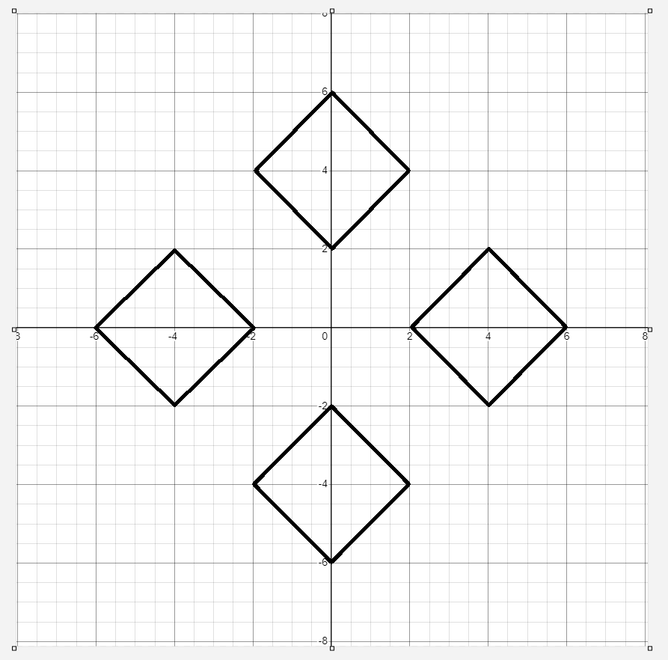
Gesture Positioning
Daniel Lu
Accomplishments since the last presentation <13.5> hrs | Ongoing progress/problems and plans until the next presentation
<10> Point cloud modeling and demo code for positioning <3.5> Sponsor Meetings | Problems: Radar demo point cloud issues, scope of project changing. Ongoing: Improve code rely on future demo data of the radar

Slide 11
Input Mapping
Zane Meikle
Accomplishments since the last presentation <14.5> hours | Ongoing progress/problems and plans until the next presentation
<3> Subsystem Introduction Project <5> initial Python code <3.5> meetings discussing issues with project <3> working on connecting Matlab to Python | Problems: Matlab won’t communicate with Python while running a script, so we must move entirely to Python Ongoing Progress: Currently working on getting two python scripts to run in parallel to have one send test data to the initial Python code to validate it is functioning

Slide 12
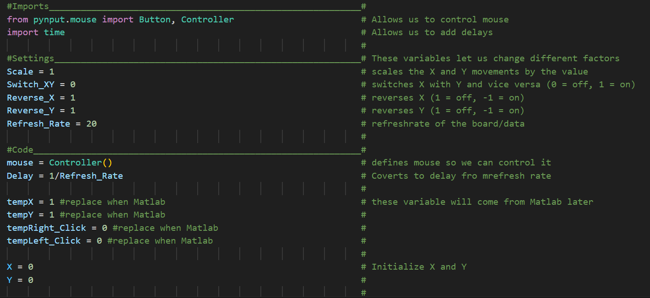
Input Mapping Initial Python Code 1

Slide 13
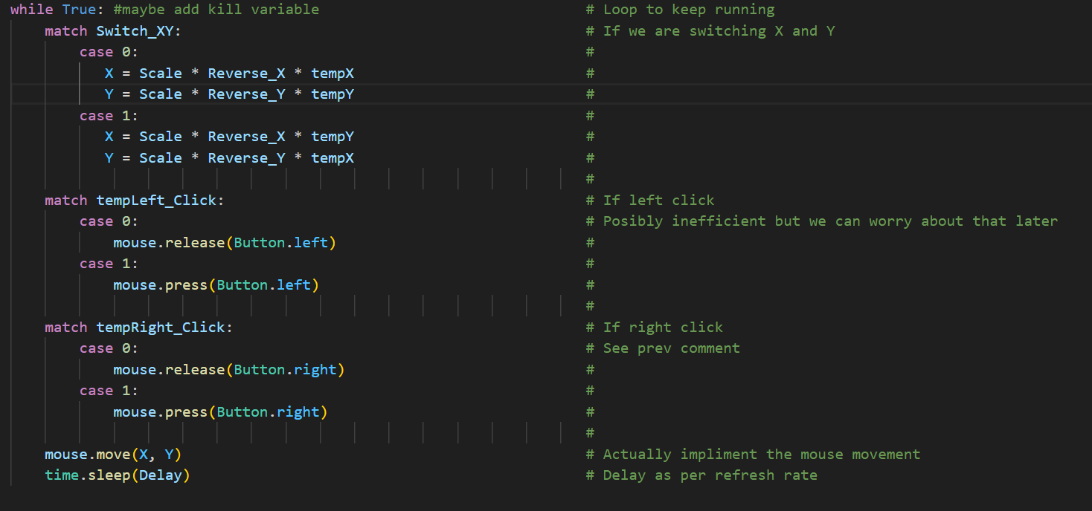
Input Mapping Initial Python Code 2

Slide 14
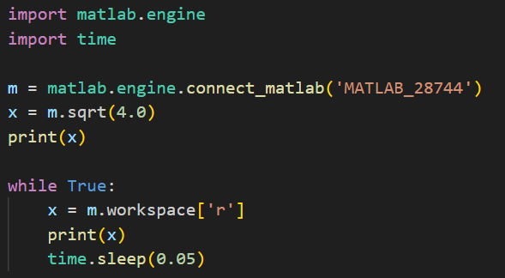
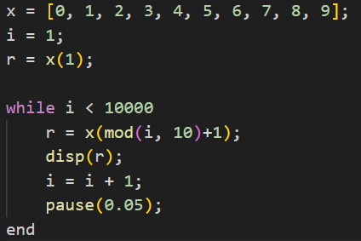
Input Mapping Connecting Matlab and Python
Python Code: Matlab Code:

Slide 15
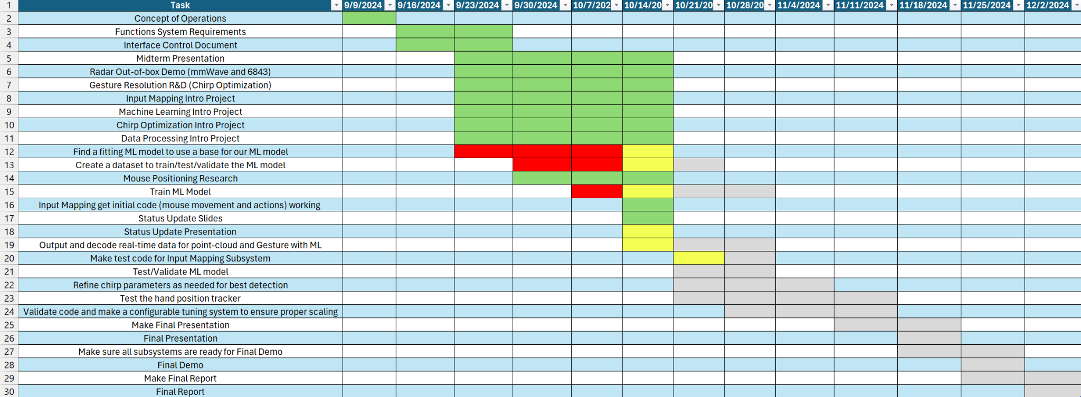
Execution Plan Gantt Chart

Slide 16
Validation plan
Task | Specification | Result | Owner
Mouse Movement | Mouse can be moved to all corners of the screen by the program. |  | Zane
Mouse Actions | The program must be able to right click and left click. |  | Zane
Hand Plots | The shape of the gesture should be represented correctly by the plots. |  | Daniel
Hands Positions | The position of the hand must be correct according to the axis of radar |  | Daniel
Hand Gesture Recognition | ML model can recognize the users hand gestures |  | Oscar
Gesture Recognition Accuracy | ML model can correctly identify and categorize hand gestures at least 90% of the time. |  | Oscar
Functional Radar System | The IWR6843AOPEVMs, and MMWAVEICBOOSTs all properly communicate with the computer and transmit data. |  | Greyson
Data Decoding | The python script accurately decodes the TLV data seen from both radars. |  | Greyson
Radar Angle | The radars can capture gestures and pointer positions within a 90 degree range up to 1.5 feet |  | Greyson
Hand Size | Radar will recognize gestures regardless of hand size. |  | Oscar

